Slide 1

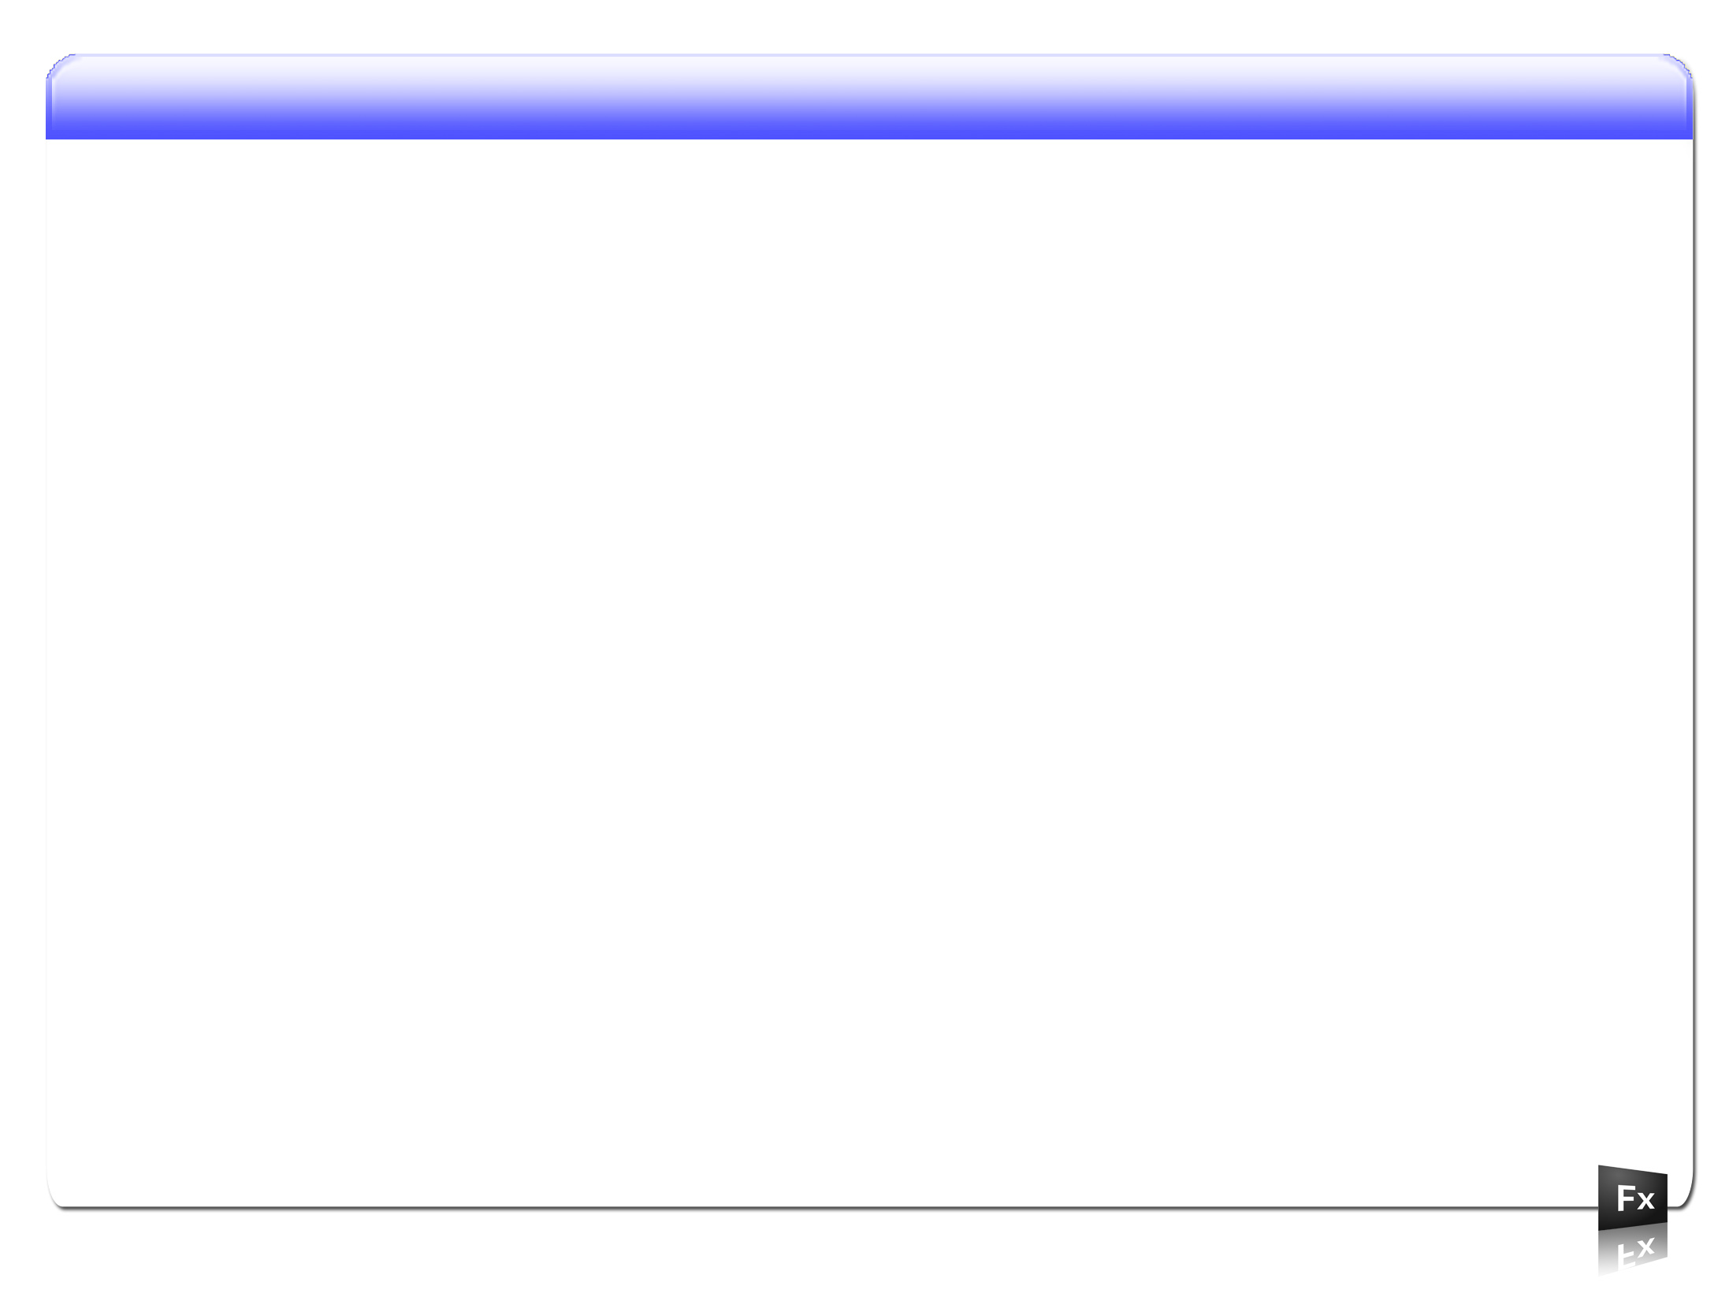
Understanding the Component LifeCycle
Axel Jensen
Copyright 2008 Axel Jensen

Slide 2
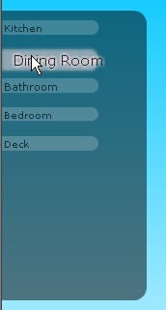
Understanding the component LifeCycle
What we are doing
A brief discussion on building an actionscript project.
Understanding how the UIComponent fits into the picture.
Creating a custom data-driven menu.
Copyright 2008 Axel Jensen

Slide 3
Understanding the component LifeCycle
The Component LifeCycle
A Component goes through a defined set of steps:
  Construction
  Configuration
  Attachment
  Initialization
  Invalidation
  Validation
  Interaction
  Detachment
  Garbage Collection
Copyright 2008 Axel Jensen

Slide 4
Understanding the component LifeCycle
LifeCycle Main Methods
When creating a custom component you typically have the following methods:
  Constructor()
  createChildren()
  commitProperties()
  measure()
  updateDisplayList()
Copyright 2008 Axel Jensen

Slide 5
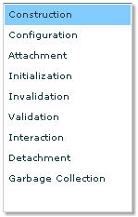


Understanding the component LifeCycle
Construction
MXML–able components must have zero arg constructors
Call super()… or the compiler will do it for you.
Good place to attach your own event handlers
Try to avoid creating children here… for best performance
OR
Copyright 2008 Axel Jensen

Slide 6
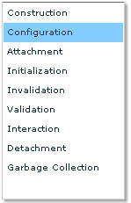
Understanding the component LifeCycle
Configuration
MXML assigns properties before components are attached or initialized (avoids duplicate code execution).
Your properties (get, set functions) need to expect that subcomponents haven’t been created yet.
Avoid creating performance bottlenecks: make set functions fast, defer work until validation.
Follow this pattern when creating sub-components.
var _labelText:String;
var _labelTextDirty:Boolean;
var _label:Label;
public function set
labelText(value:String):void
{
_labelText = value;
//BAD _label.text = labelText
_labelTextDirty = true;
invalidateProperties();
}
...
instance.dataProvider = xmlDataSet;
instance.width = 600;
instance.height = 200;
instance.labelText = “hello”;
...
Copyright 2008 Axel Jensen

Slide 7
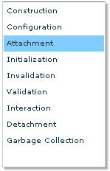
Understanding the component LifeCycle
Attachment
The attachment phase is when the component is added to the display list through any of the following methods:
  addChild()
  addChildAt()
  When declaring the component via MXML
This step will invoke the component’s internal initialize() function
...
parentComponent.addChild();
parentComponent.addChildAt();
...
Copyright 2008 Axel Jensen

Slide 8
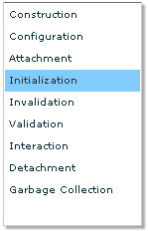
Understanding the component LifeCycle
Initialization
initialization happens in multiple sub-phases:
  ‘preinitialize’ event is dispatched
  createChildren method is called, adds sub-components
  ‘initialize’ event is called – component is fully created
  First validation pass occurs
  ‘creationComplete’ event is fired – component is fully commited, measured, and updated.
Copyright 2008 Axel Jensen

Slide 9
Understanding the component LifeCycle
Initialization
Override createChildren to create and attach your component’s sub-pieces.
Creating children here streamlines startup performance
Follow the same pattern MXML uses: create, configure, attach.
Don’t forget to call super.createChildren();
Defer creating dynamic and data-driven components to commitProperties();
protected var commitButton:UIComponent;
override protected function createChildren():void
{
  if (commitButton == null)
  {
  commitButton = new Button();
  Button(commitButton).label = “OK”;
  }
  addChild(commitButton);
  commitButton.addEventListener(MouseEvent.CLICK, commitHandler);
  super.createChildren();
}
Copyright 2008 Axel Jensen

Slide 10
Understanding the component LifeCycle
Initialization
3 Important Rules for adding children:
  Containers must contain only UIComponents
  UIComponents must go inside other UIComponents.
  UIComponents can contain anything (Sprites, Shapes, MovieClips, Video, etc).
Copyright 2008 Axel Jensen

Slide 11
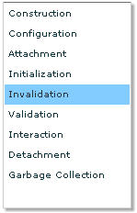
Understanding the component LifeCycle
Invalidation
Flex imposes a deferred validation model on the underlying Flash API
Aggregate changes, defer work until the last possible moment
avoid creating performance traps for your customers
Three main invalidation functions:
  invalidateProperties() for deferred calculation, child management
  invalidateSize() for changes to the measured size of a component
  invalidateDisplayList() for changes to the appearance of a component
Rules of Thumb:
  Change values immediately
  Dispatch events immediately
  Defer Side-effects and calculations to commitProperties()
  Defer rendering to updateDisplayList()
  Be suspicious of rules of Thumb
Copyright 2008 Axel Jensen

Slide 12
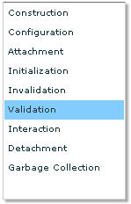
Understanding the component LifeCycle
Validation
commitProperties()
    Invoked by the framework immediately before measurement and layout
    Use it to calculate and commit the effects of changes to properties and underlying data
    Avoid extra work: Use flags to filter what work needs to be done
    Proper place to destroy and create subcomponents based on changes to properties or underlying data.
Copyright 2008 Axel Jensen

Slide 13
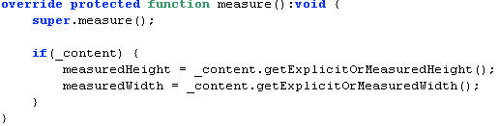
Understanding the component LifeCycle
Validation
measure()
    Invoked by the framework when a component’s invalidateSize() is called
    Implicitly invoked when component children change size.
    Don’t count on it: Only called when the explicitWidth or explicitHeight properties are NaN.
    Quick Tip: start by explicitly sizing your component, and implement this later.
Copyright 2008 Axel Jensen

Slide 14
Understanding the component LifeCycle
Validation
updateDisplayList()
    Invoked by the framework when a component’s invalidateDisplayList() is called
    The ‘right’ place to do all of your drawing and layout.
    You’ll hear more about this later.
Copyright 2008 Axel Jensen

Slide 15
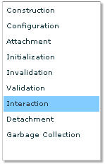
Understanding the component LifeCycle
Interaction
Flex is an Event Driven Interaction Model
Events consist of:
    Name: A unique (per target) name identifying the type of event
    Target: the object that dispatched the event
    Event: An Object containing additional information relevant to the event
    Handler: the function invoked when the event occurs.
You’ll deal with events in two ways:
Handling Events
  Registering, and removing
Dispatching Events
  Flex’s event system is extensible – you can define the events you need to make your component useful.
Copyright 2008 Axel Jensen

Slide 16
Understanding the component LifeCycle
Interaction
How to dispatch your own event
Pick a name
    Choose something descriptive. If the name is already in use, try to make sure your event has the same basic meaning.
    Flex defines event constants to make AS coders lives easier. You should too.
    Flex naming convention: events that signify something is about to happen are gerunds (end in –ing) (itemOpening, stateChanging). Events that signify something has happened are present tense verbs (click, itemRollOver).
Define An Event class
    Define your own class, at least to own your event constant. Add additional fields if there is data your developers might find relevant.
    It’s OK to reuse the same event class if it seems to make sense.
Copyright 2008 Axel Jensen

Slide 17
Understanding the component LifeCycle
Interaction
3. Declare your intent to dispatch the event
    Class level Metadata let’s the compiler (and future doc tools) know that your component dispatches this event, and what Event class it uses.
[Event(name="itemClick", type="randomWalkClasses.RandomWalkEvent")]
public class RandomWalk extends UIComponent { ...
4. Decide if you should bubble.
dispatchEvent(new RandomWalkEvent(RandomWalkEvent.ITEM_CLICK,node));
Copyright 2008 Axel Jensen

Slide 18
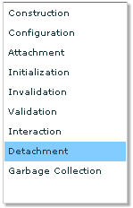
Understanding the component LifeCycle
Detachment
The Flash Display List is putty in your hands
Components can be added, removed, reparented, etc.
Things to note:
    Components off the display list don’t get validation calls
    Reparenting is not as expensive as initialization, but does have a cost
    For volatile sub-components, consider hiding instead of removing
    bookmarkDock.addChild( browsePanel.selectedProductView );
Copyright 2008 Axel Jensen

Slide 19
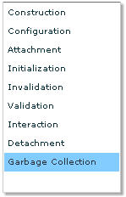
Understanding the component LifeCycle
Garbage Collection
Components removed from the display list will be garbage collected automatically
Beware the dark side…manage your references carefully!
Common causes of memory leaks:
    Event Listeners (especially on data)
    Mapping Dictionaries
Flash provides weak references in these cases
Quick Tip: Remember, if you use a weak reference, make sure the object/function/etc. is being referenced by someone else.
myObject.addEventListener(“change”,
function () { … }, false,0,true); // Uh Oh!
Copyright 2008 Axel Jensen

Slide 20
Understanding the component LifeCycle
Checklist
  Constructor()
  createChildren()
  commitProperties()
  measure()
  updateDisplayList()
  Custom Events
Copyright 2008 Axel Jensen

Slide 21
Understanding the component LifeCycle
Links
  Ely Greenfields slides
    http://flex.org/ACDS/BuildingAFlexComponent.pdf
  Real eyes media slides
    http://labs.realeyesmedia.com/downloads/techBriefs/AdvancedCustomComponents_20071102.pdf
  Axels Blog
    http://axelscript.com
Copyright 2008 Axel Jensen

